Slide 1
INCIDENCE AND CRIME MANAGEMENT SYSTEM A CASE OF SONDU POLICE STATION
CMT 400 : Research Project Progress Report
Name : KIBET GILBERT KORIR | REG. Num: 1042459
Supervisor: MR CHRISPINUS NANDASABA

Slide 2
Content
Background of the Research
Problem Statement
Main & Specific Objectives
Analysis
Design
Implementation

Slide 3
Background of the research
Sondu Police Station, like many law enforcement entities, aims to provide safety services efficiently to meet citizen needs.
There is a growing interest in using technology, such as online crime management systems, to streamline crime management processes.
An online automated Incidence and Crime Management System aims to offer a convenient method for recording and managing crime data, improving accuracy, speed, and accountability.
Apart from enhancing efficiency, the system allows officers to record incidents easily and enables real-time monitoring of crime data for informed decision-making.
Implementing such a system requires a significant investment but promises long-term benefits in efficiency, transparency, and accountability

Slide 4
Main Objective
Help citizens report incidents easily

Slide 5
Specific objectives
Reduce time and energy among citizens in case reporting and enhance efficiency
Reduce incidents of corruption and delay in case handling
Make case records easily available for all users

Slide 6
Analysis(1)
Requirements analysis
Functional
Record daily crime records.
Generate reports and provide real-time insights into crime insights.
Enhance or availability of community donations
Automate crime recording processes.
Ease in case tracking
Non-functional requirements
Security measures such as user authentication and access control. Scalability to accommodate an increasing volume of users and crime reports.

Slide 7
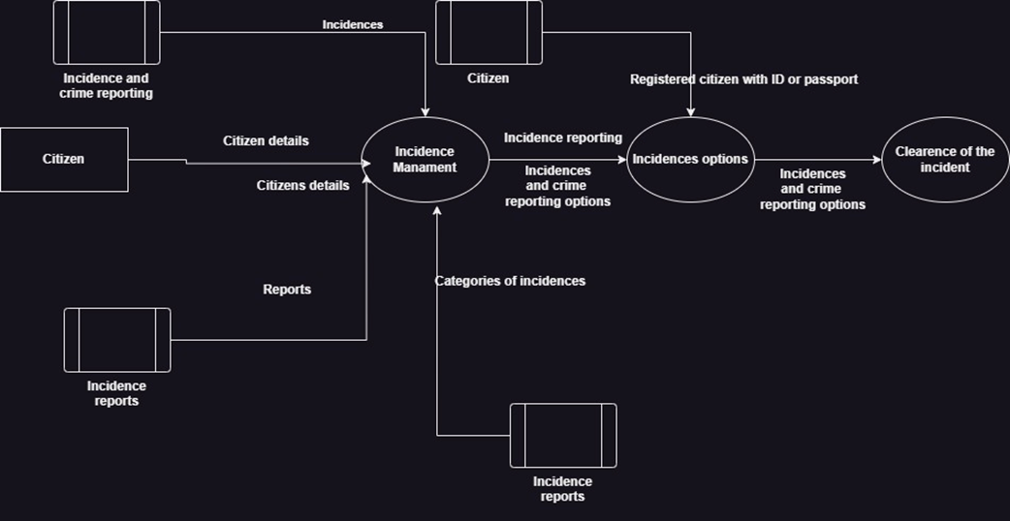
Analysis(2)
System analysis:

Slide 8
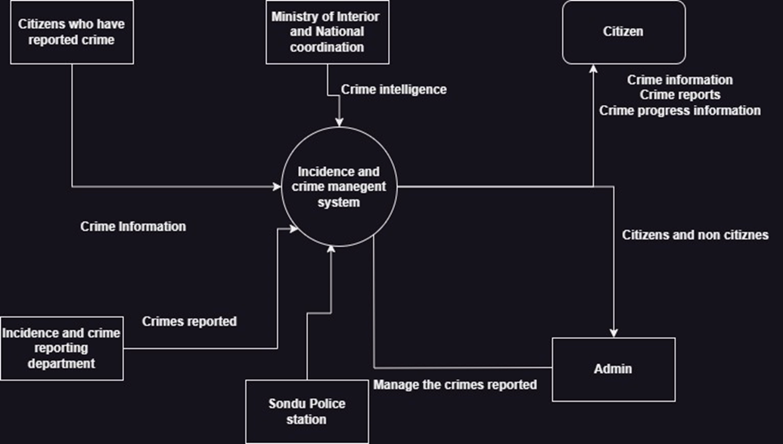
Analysis(2)
System analysis:

Slide 9
Analysis(3)
System users/actors
Admin
Police
Citizen/Users
System Input/ Input forms
Login forms for all users
The signup form for the citizen
The report case/incident form
The update forms for the admin(Manage users, Police schedule, manage location)
System output/ Reports
System log reports
OB number generation
System to know the logged in user
Emails
System Entities
Citizens
Reporting crimes/ Verify case/Decline case/Update users
Police

Slide 10
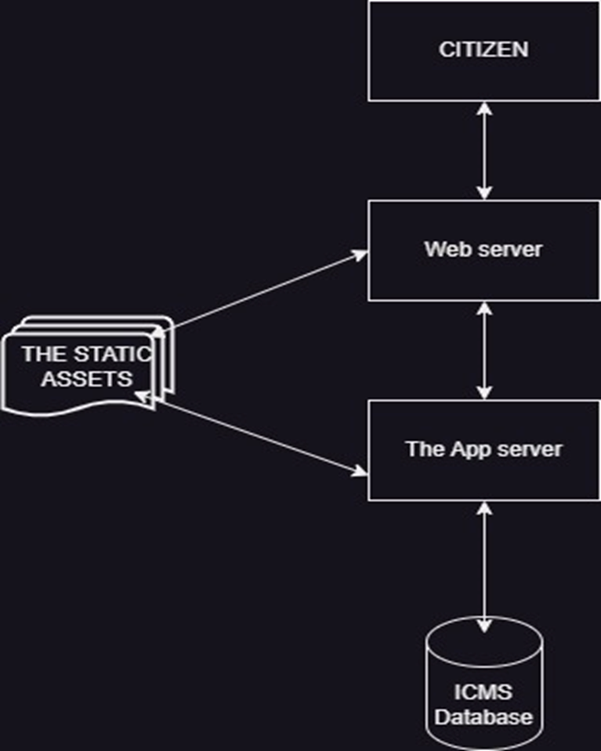
System Design (1)
Process design

Slide 11
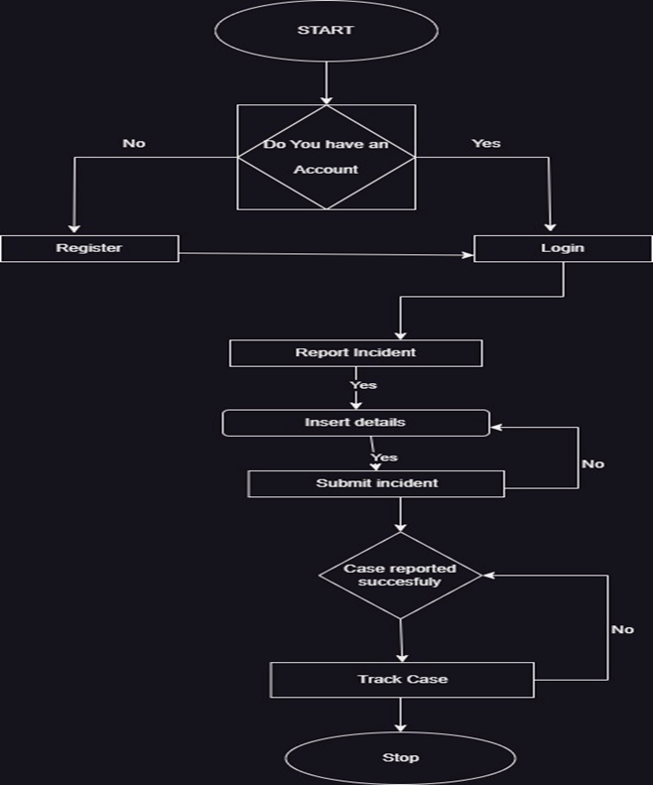
System Design (1)
Process design

Slide 12
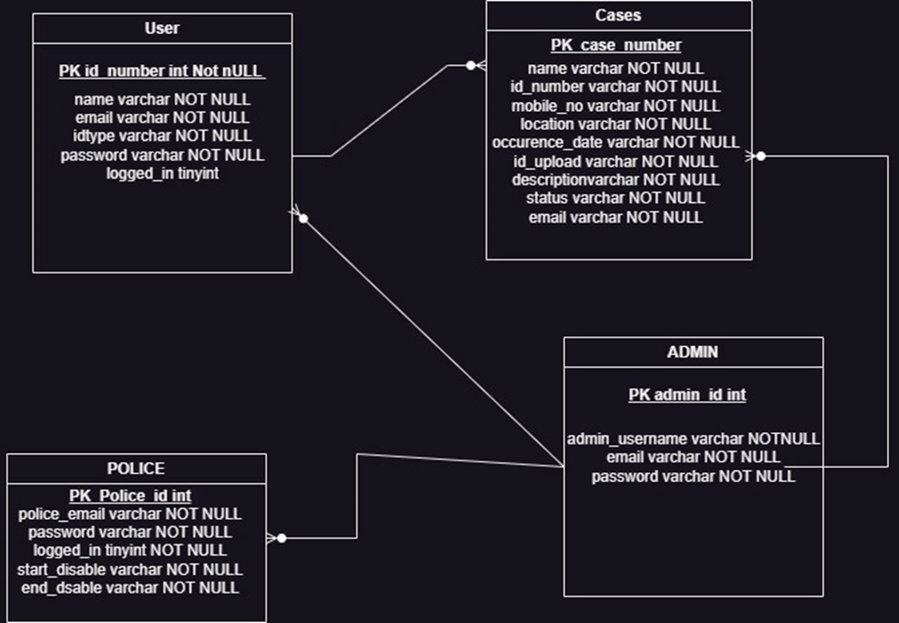
Design(2)
Database Design(ERD)

Slide 13
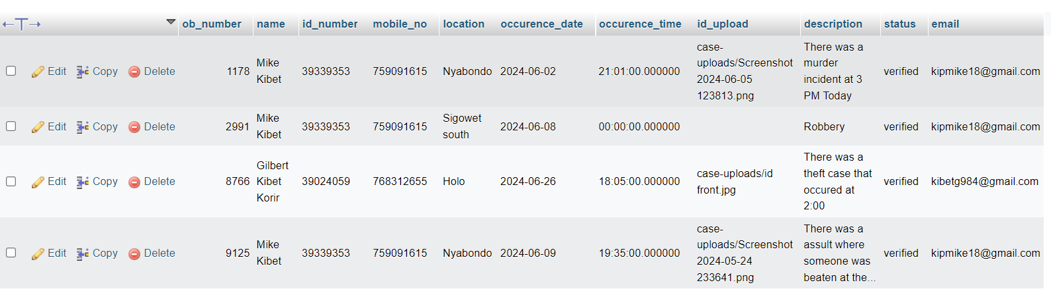
Design(3)
Test data

Slide 14
Implementation
Created user side page
(Signup, login, Landing index, landing, dashboard, report incident, donations and track case)
Created the Police side page
(View assigned cases, verify, decline and update criminals
Created the Admin Page
(Dashboard, Manage users, police schedule, reports, Manage locations, Settings and logout

Slide 15
The End
Thank you

